Slide 1
Asapu Radhika mahalakshmi Final Project

Slide 2


Slide 3


AGENDA
Project Setup and Research Development
Introduction
Project Overview
Problem Statement
Who are the end users?
Solution and Value Proportion
The WOW in the solution
Modelling
Results
Documentation and Presentation
3/21/2024 Annual Review

Slide 4
INTRODUCTION
Keylogger:
Keyloggers also known as keystroke loggers , may be defined as the recording of the key pressed on a system and saved it to a file is accessed by the person using this malware. A keylogger is a form of malware or hardware that keeps track of and records your keystrokes as you type. It takes the information and sends it to a hacker using a command-and-control (C&C) server. The hacker then analyses the keystrokes to locate usernames and passwords and uses them to hack into otherwise secure systems. Keylogger can be software or can be hardware. Both types of keyloggers can be used for malicious purposes, including credential theft and identity theft.
Example of keyloggers :
Magic Lantern :
Developed by the FBI.
Is installed remoted via email attachment.
All in One Keylogger Spy Software :
Sends encrypted logs to desired email.
Tracks all users activity.

Slide 5
Software Keyloggers :
Software Keyloggers consist of applications that have to be installed on a computer to steal keystroke data. They are the most common method hackers use to access a user’s keystrokes . A software keylogger is put on a computer when the user downloads an infected application . Once installed , the keylogger monitors the keystrokes on the operating system you are using , checking the paths each keystroke goes through . In this way , a software keylogger can keep track of your keystrokes and record each one. Software keyloggers are also called as SPY software.These software loggers are easy to implement – code is relatively normal. And hard to install – user can notice the presence of it.
Applications of a software Keylogger :
It is used to record keystrokes entered by the user.
It can be used to take any snapshots of any website that the user visits.
It can also be used by the family member to monitor activities.
Advantages of a software keylogger :
It can be installed on a system when the victim opens the attachment sent in an email.
It gives the advantage of taking snapshots, recording videos, and more.
They are not physically detectable.
Disadvantage of software keylogger :
It sometimes gets detected by Anti-spyware.
Detect software keylogger :
The user should have an anti-virus system. It should enable the user to detect any software keylogger.
The user should look at all the files that have been installed. If any files look suspicious, the user should immediately remove that file.

Slide 6
Hardware Keyloggers :
A hardware keylogger works much like its software counterpart . The biggest difference is hardware keyloggers have to be physically connected to the target computer to record the user’s keystrokes . For this reason , it is important for an organization to carefully monitor who has access to the network and the devices connected to it . If an unauthorized individual is allowed to use a device on the network , they could install a hardware keylogger that may run undetected until it has already colltcted sensitive information . After hardware keystroke loggers have finished keylogging , they store the data , which the hacker has to download from the device. The hardware keyloggers are comes three types :
Inline devices that are attached to the keyboard cable.
Devices which can be installed inside standard keyboards.
Replacement keyboards that contain the keylogger already built-in.
Some hardware keyloggers :
Hardware KeyLogger Stand-alone Edition
A tiny hardware device that can be attached in between a keyboard and a computer.
Hardware KeyLogger Keyboard Edition
Looks and behaves exactly like a normal keyboard, but it keeps a record of all keystrokes typed on it.
Advantages of Hardware keylogger :
It is undetectable.
It is not detectable by the anti-virus.
Disadvantages of Hardware keylogger :
It can acts as a disadvantage if it is found by someone.
They ae physically detectable.

Slide 7

PROJECT OVERVIEW:
Develop a comprehensive understanding of keyloggers,
their types, how they work, and effective security measures to prevent
keylogging attacks.
Advantages:
Antivirus techniques cannot catch these.
Work on all computing platforms.
Are hard to detect.
Are fairly easy to write.
Can be deployed remotely via a software vulnerability attack.
Disadvantages:
It can be spotted by a suspicious user.
A good antivirus scheme could sniff these out.
In case of software keyloggers , It is easy for hacker to steal their victim’s personal info.
Far fewer cons with the software , so these are much more common than hardware-type keyloggers.

Slide 8

PROBLEM STATEMENT
In the modern digital era, keyloggers are frequently used for malicious purposes such as stealing sensitive information including passwords, credit card numbers, and personal messages. Despite their negative connotations, keyloggers can also be utilized for legitimate purposes such as parental monitoring, employee monitoring, or security testing. The main challenge lies in developing a keylogger that can serve ethical purposes while ensuring privacy and security.
Keyloggers are a significant threat to cybersecurity, leading to unauthorized access to sensitive information , identify theft , and financial fraud.
Affects individuals , businesses , organizations by compromising data privacy and security.

Slide 9
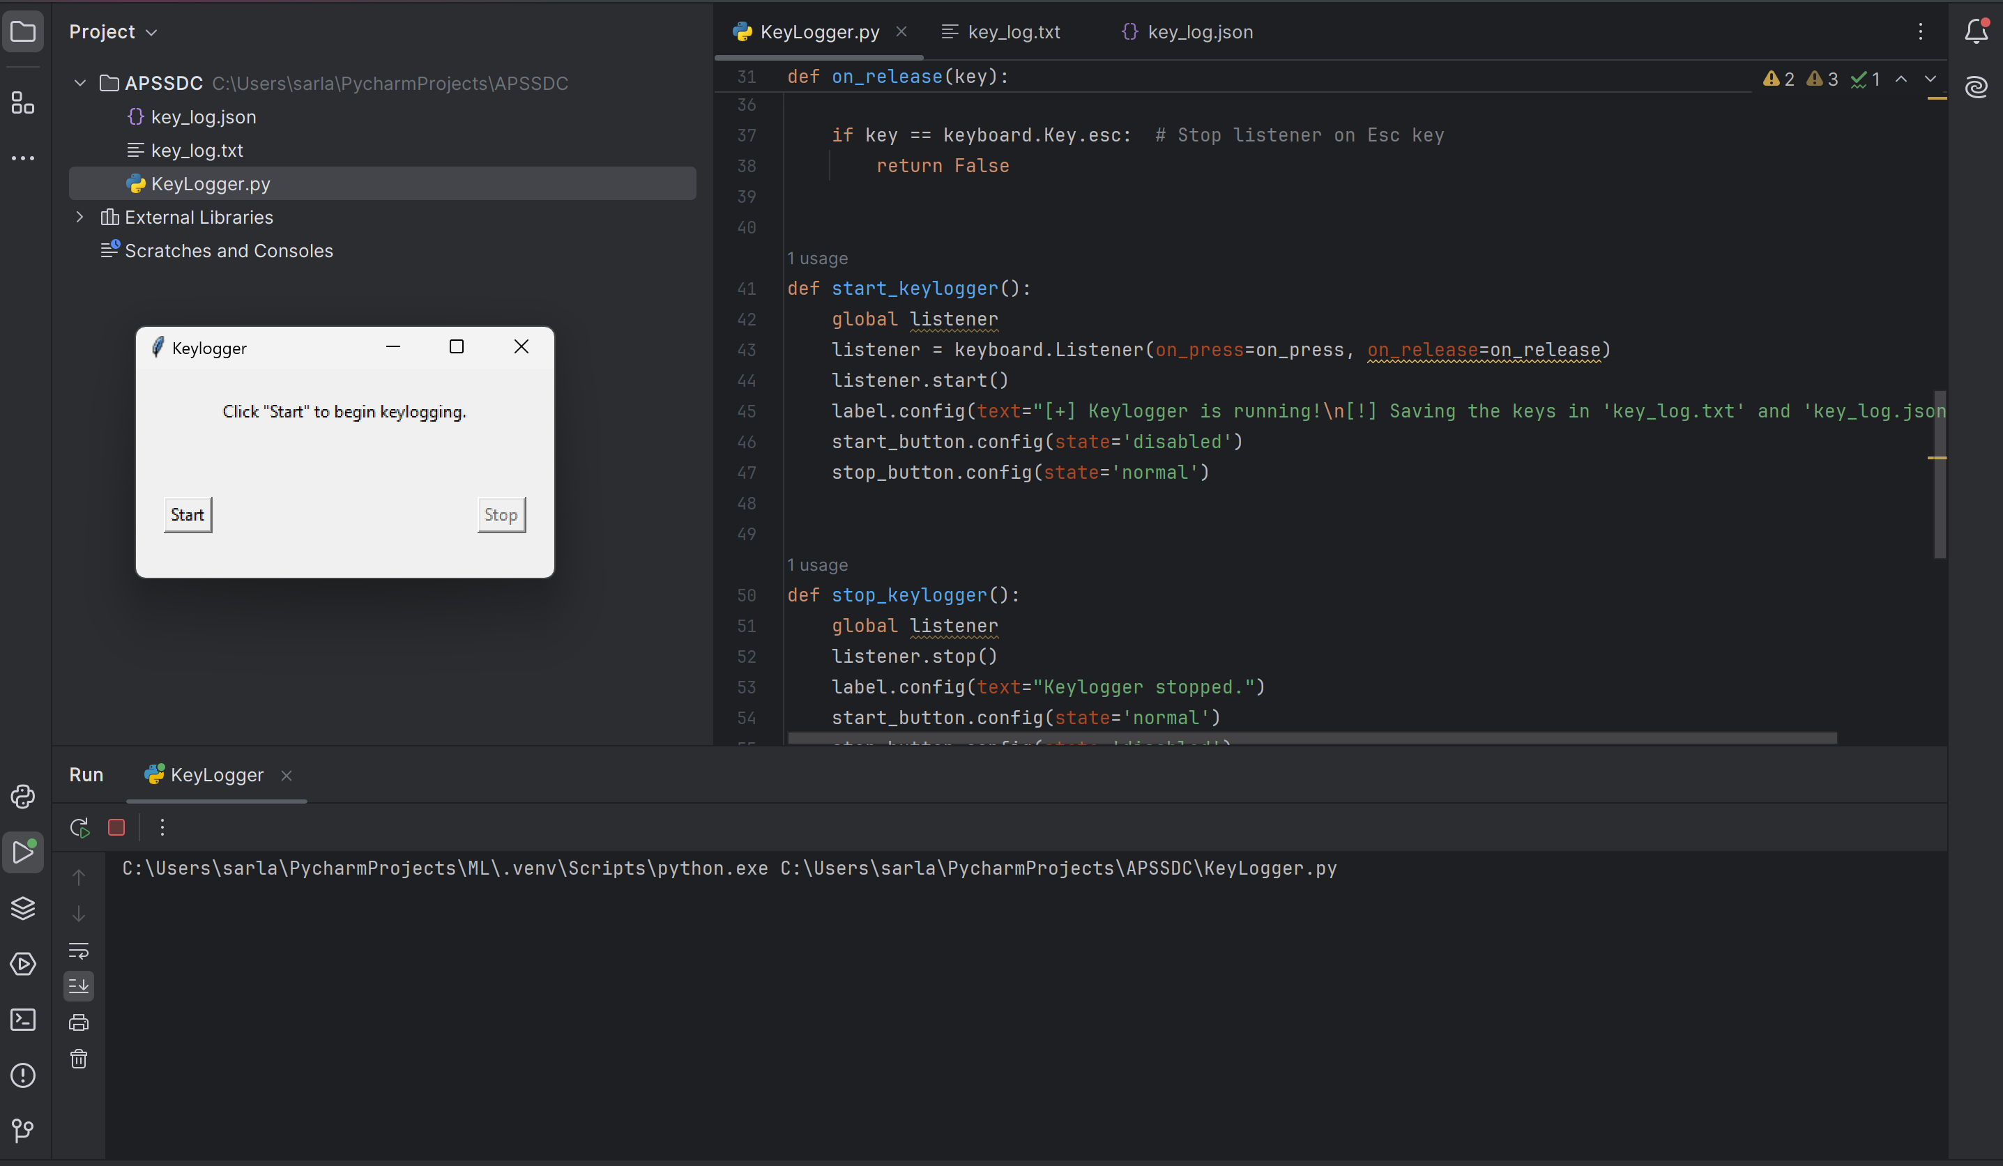
WHO ARE THE END USERS?
Investigators.
Employers.
Parental Monitors.
Security professional.
Educational Institutes.

Slide 10

YOUR SOLUTION AND ITS VALUE PROPOSITION
Solution Overview:
1. Anti- Keylogger: As the name suggest these are the software which are anti against key loggers and main task is to detect key-logger from a computer system.
2. Key Features: Accurate logging, secure storage, and user-friendly interface.
3. Value Proposition: Ensures safety, productivity, and privacy for users.
4.One-Time-Passwords:Using OTP’s as password may be safe as every time we login we have to use a new password.
5. Automatic form filler : This technique can be used by the user not to fill forms on regular basis instead use automatic form filler which will give a shield against key-loggers as keys will not be pressed.

Slide 11

THE WOW IN YOUR SOLUTION
Wow Factor:
Innovative Approach : Combining technical measures with user education for comprehensive protection.
Uncompromising Security: Utilizes encryption and ethical guidelines to safeguard data with integrity.
Empowering Insights: Provides invaluable insights into user behavior for enhanced safety and productivity.
Ethical Ingenuity: Demonstrates a pioneering approach to monitoring that prioritizes privacy and responsibility.
11

Slide 12
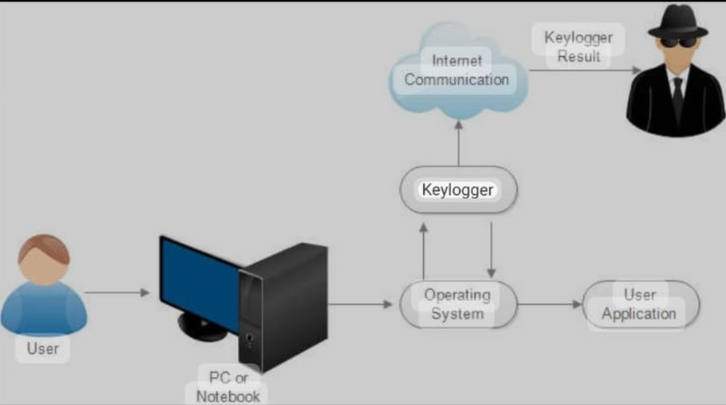
MODELLING
Modelling and wireframes Collaboration :
Keylogger applications designed by implementing the Exact String Matching algorithm can record all user activities related to the keyboard , and the results are stored automatically in a dedicated database that can only be accessed by the keylogger owner , the next development of the keylogger application can record . Here we can observe the how a keylogger works from the mentioned block diagram.
System Approach:
The System Approach section outlines the overall strategy and methodology for developing and implementing keylogger and security . Here’s a suggested structure for this section:
System requirements
Python IDLE
Library required to build the model
PYNPUT
JSON

Slide 13
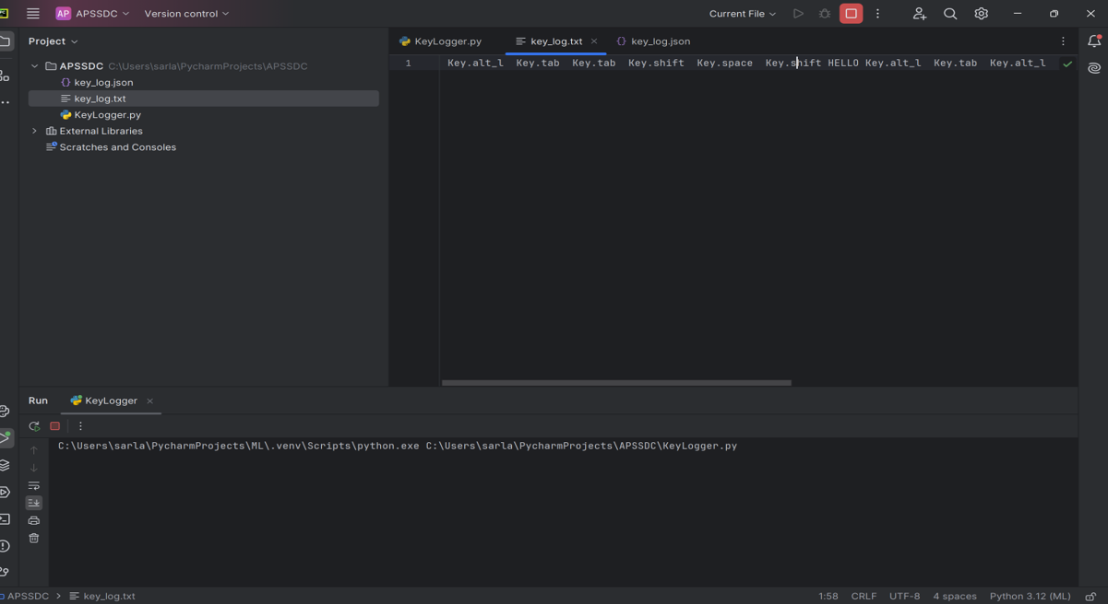
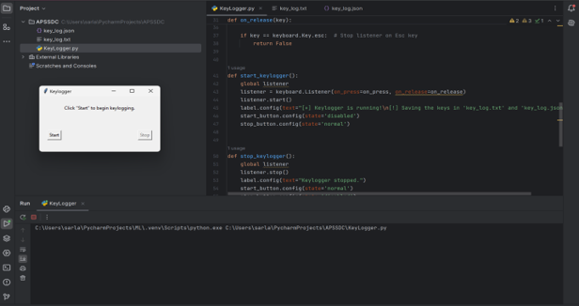
RESULTS
After clicking the start button and typing any thing It will be recorded in the key.txt as shown above.
Thus , we conclude that Keyloggers are a potent threat to both individuals and enterprises , with the
Potential to cause significant harm if left undetected . Understanding the nature of keyloggers , their methods
of infiltration. In this keylogger and security project, demonstrated the capability to effectively capture and log keystrokes in real-time and it is done practically by us. Thus emphasized the ethical use of keyloggers and the importance of implementing security measures to protect against the malicious use.
13

Slide 14
THANK YOU

